Slide 1
Chapter 14 JavaFX Basics

Slide 2
Motivations
JavaFX is a new framework for developing Java GUI programs. The JavaFX API is an excellent example of how the object-oriented principle is applied. This chapter serves two purposes. First, it presents the basics of JavaFX programming. Second, it uses JavaFX to demonstrate OOP. Specifically, this chapter introduces the framework of JavaFX and discusses JavaFX GUI components and their relationships.

Slide 3
Objectives
To distinguish between JavaFX, Swing, and AWT (§14.2).
To write a simple JavaFX program and understand the relationship among stages, scenes, and nodes (§14.3).
To create user interfaces using panes, UI controls, and shapes (§14.4).
To use binding properties to synchronize property values (§14.5).
To use the common properties style and rotate for nodes (§14.6).
To create colors using the Color class (§14.7).
To create fonts using the Font class (§14.8).
To create images using the Image class and to create image views using the ImageView class (§14.9).
To layout nodes using Pane, StackPane, FlowPane, GridPane, BorderPane, HBox, and VBox (§14.10).
To display text using the Text class and create shapes using Line, Circle, Rectangle, Ellipse, Arc, Polygon, and Polyline (§14.11).
To develop the reusable GUI components ClockPane for displaying an analog clock (§14.12).

Slide 4
JavaFX vs Swing and AWT
Swing and AWT are replaced by the JavaFX platform for developing rich Internet applications.
When Java was introduced, the GUI classes were bundled in a library known as the Abstract Windows Toolkit (AWT). AWT is fine for developing simple graphical user interfaces, but not for developing comprehensive GUI projects. In addition, AWT is prone to platform-specific bugs. The AWT user-interface components were replaced by a more robust, versatile, and flexible library known as Swing components. Swing components are painted directly on canvases using Java code. Swing components depend less on the target platform and use less of the native GUI resource. With the release of Java 8, Swing is replaced by a completely new GUI platform known as JavaFX.

Slide 5
Basic Structure of JavaFX
Application
Override the start(Stage) method
Stage, Scene, and Nodes
MyJavaFX
Run
MultipleStageDemo
Run

Slide 6
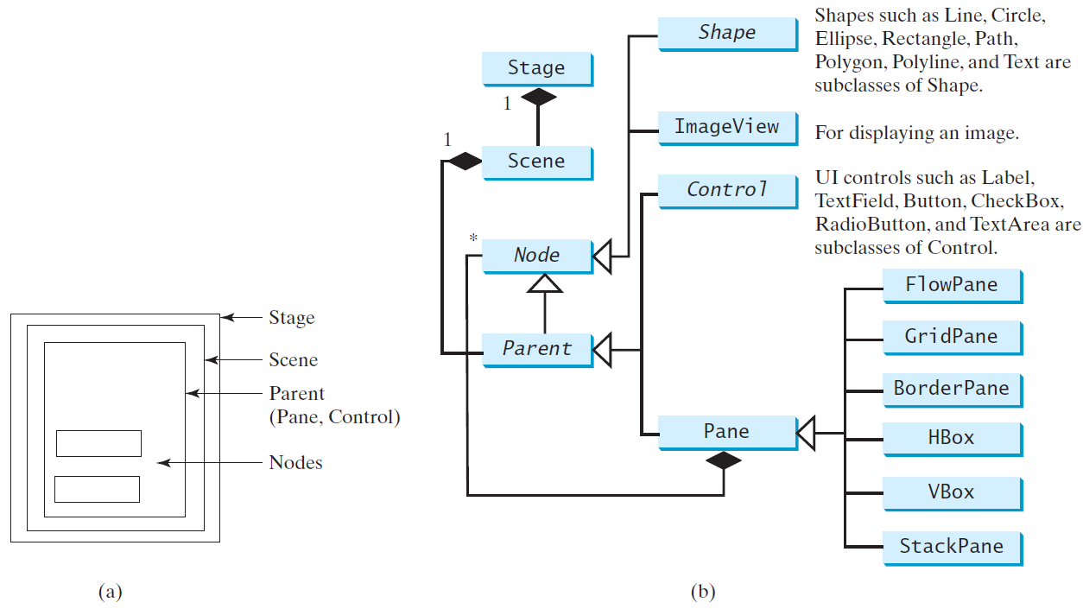
Panes, UI Controls, and Shapes
ButtonInPane
Run

Slide 7
Display a Shape
This example displays a circle in the center of the pane.
ShowCircle
Run

Slide 8
Binding Properties
JavaFX introduces a new concept called binding property that enables a target object to be bound to a source object. If the value in the source object changes, the target property is also changed automatically. The target object is simply called a binding object or a binding property.
ShowCircleCentered
Run

Slide 9
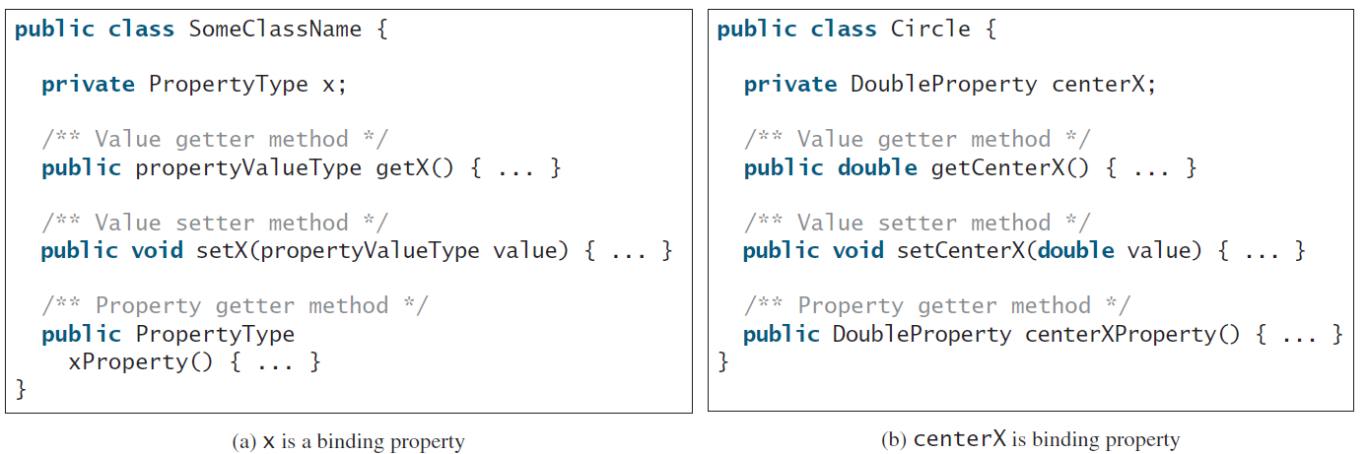
Binding Property: getter, setter, and property getter

Slide 10
Uni/Bidirectional Binding
BidirctionalBindingDemo
Run

Slide 11
Common Properties and Methods for Nodes
style: set a JavaFX CSS style
rotate: Rotate a node
NodeStyleRotateDemo
Run

Slide 12
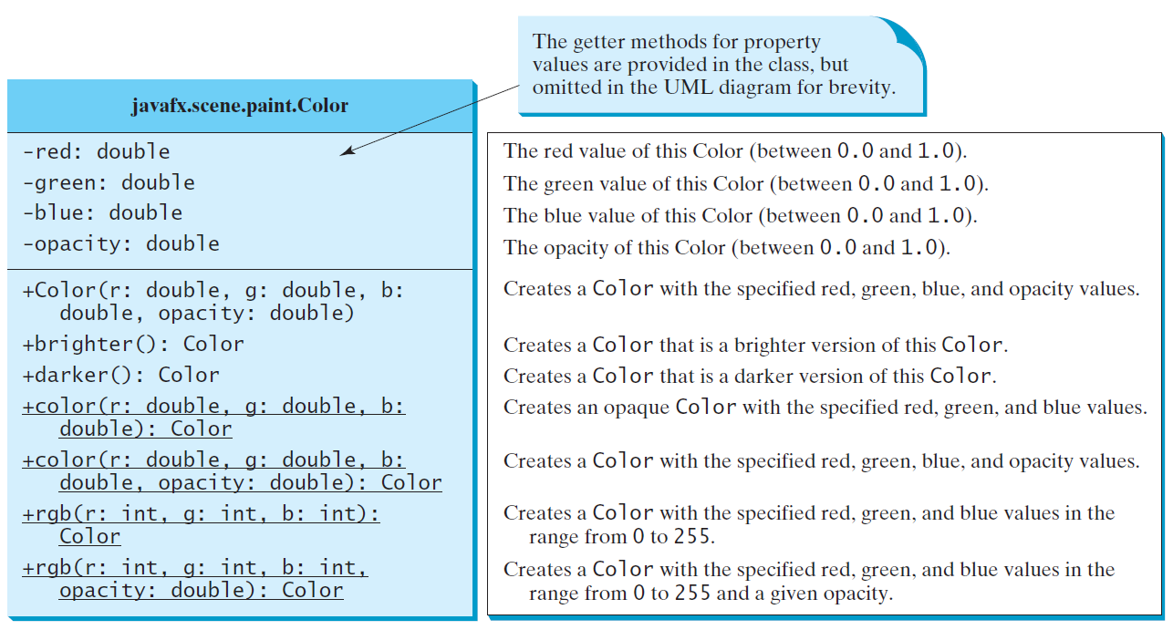
The Color Class

Slide 13
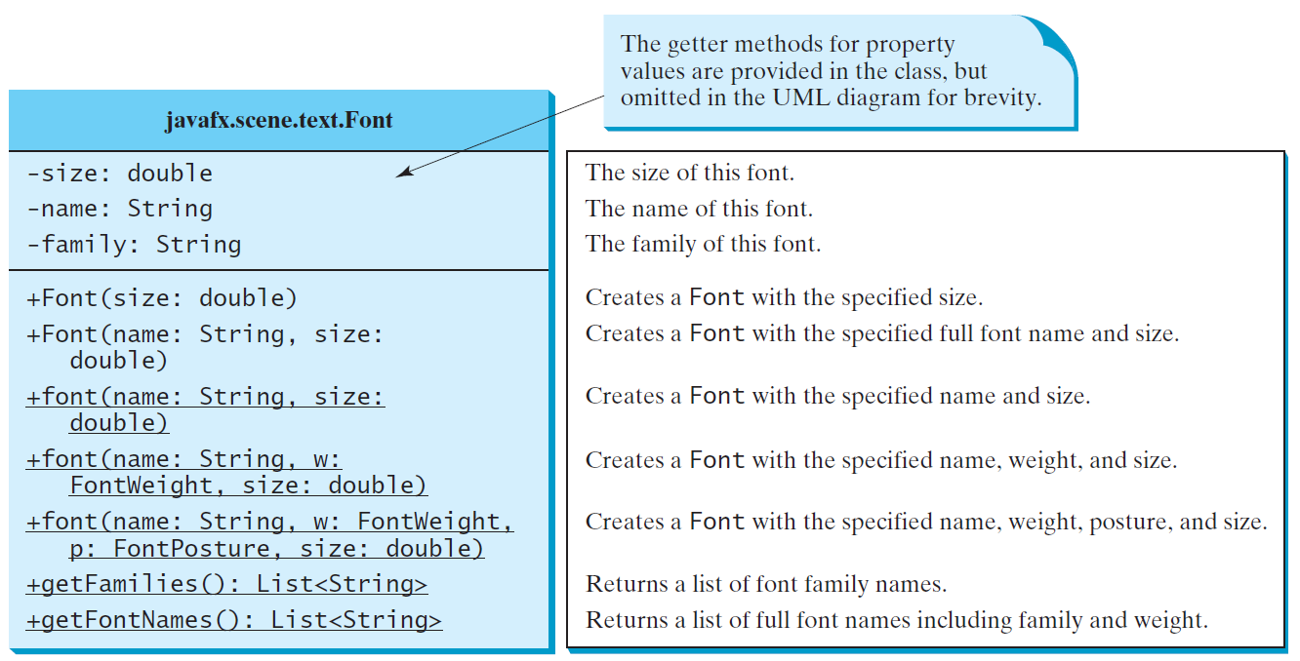
The Font Class
FontDemo
Run

Slide 14
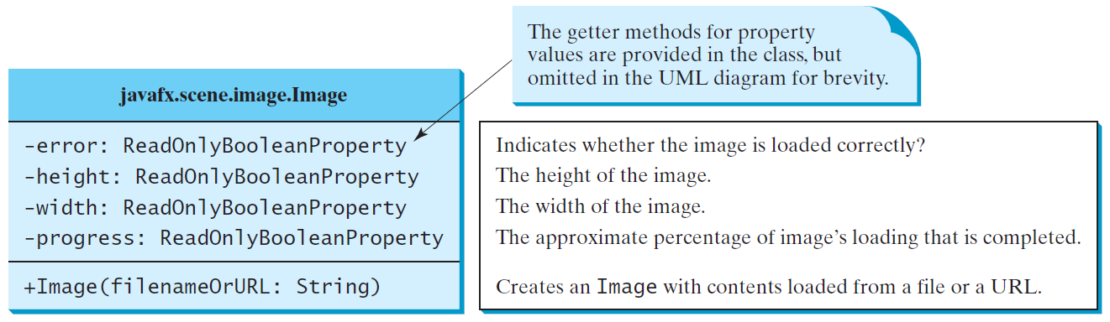
The Image Class

Slide 15
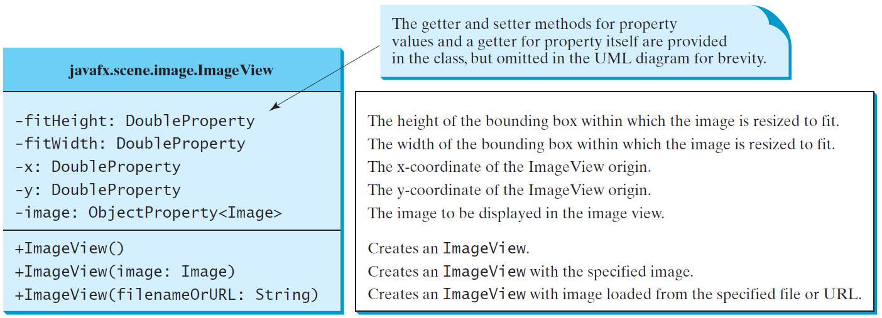
The ImageView Class
ShowImage
Run

Slide 16
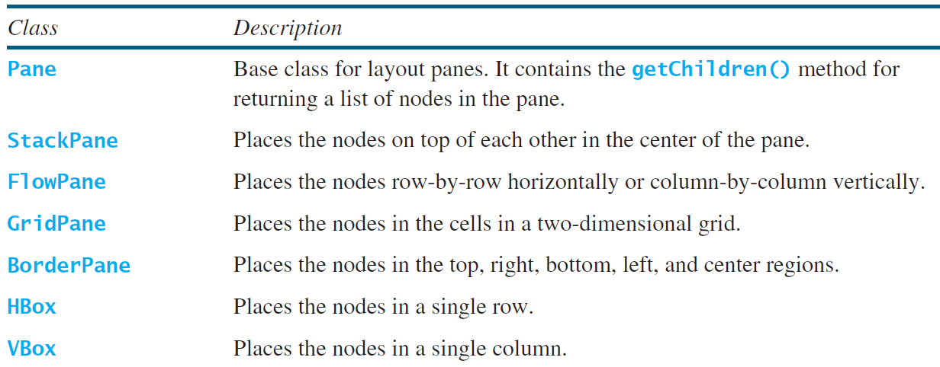
Layout Panes
JavaFX provides many types of panes for organizing nodes in a container.

Slide 17
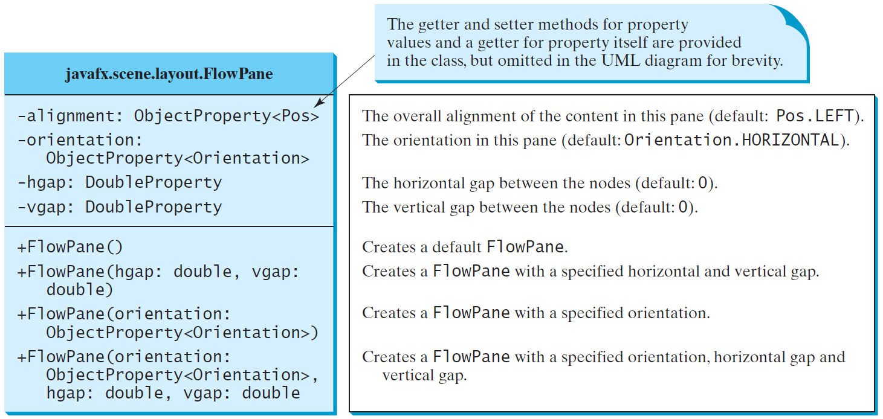
FlowPane
ShowFlowPane
Run

Slide 18
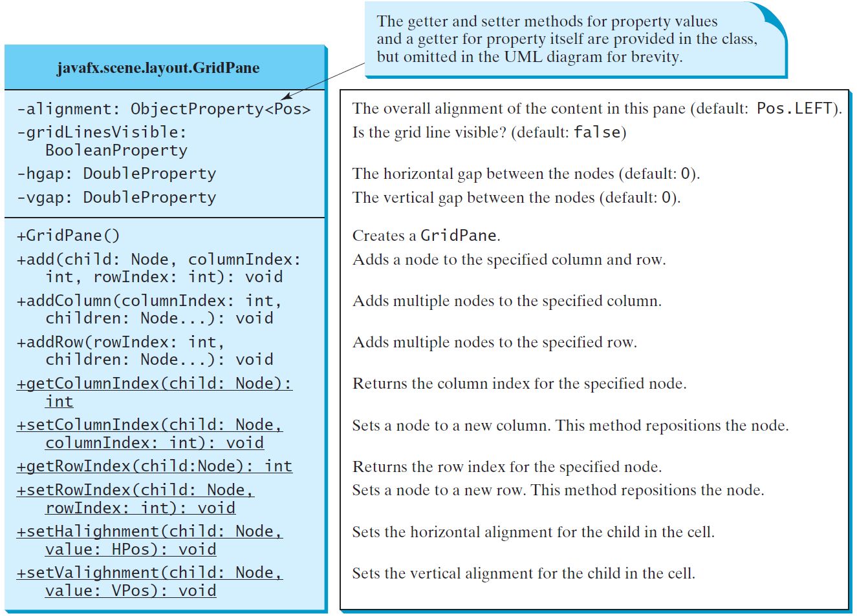
GridPane
ShowGridPane
Run

Slide 19
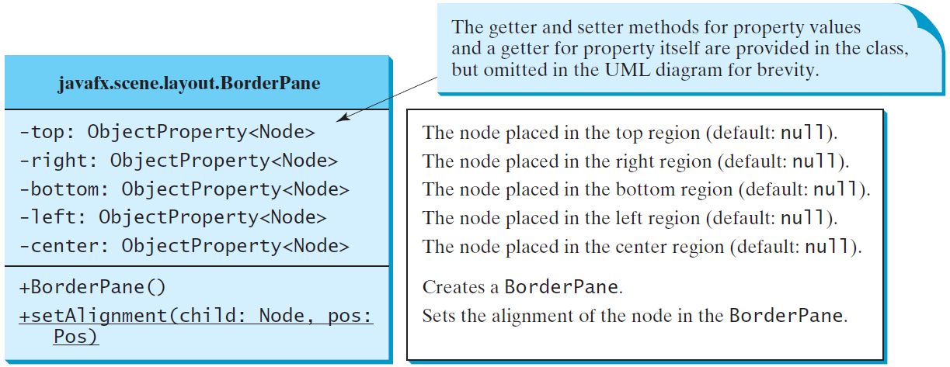
BorderPane
ShowBorderPane
Run

Slide 20
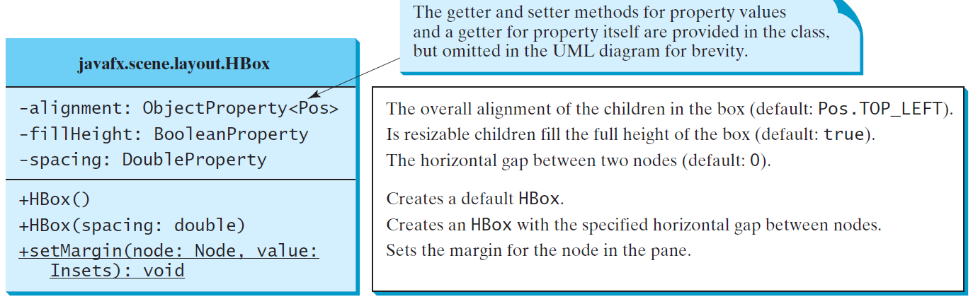
HBox

Slide 21
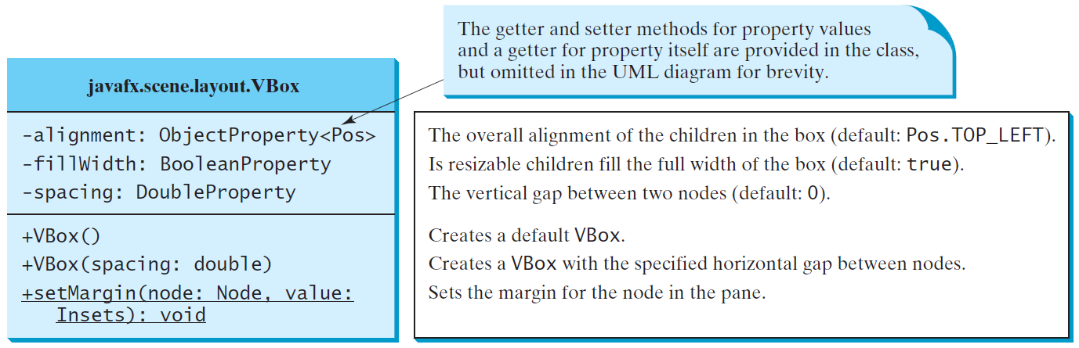
VBox
ShowHBoxVBox
Run

Slide 22
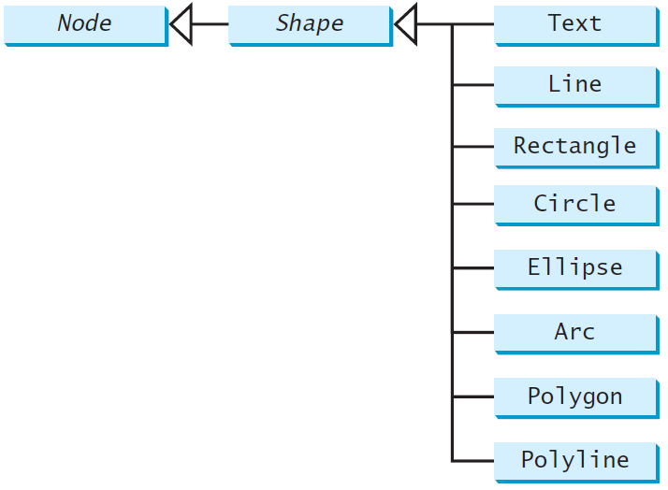
Shapes
JavaFX provides many shape classes for drawing texts, lines, circles, rectangles, ellipses, arcs, polygons, and polylines.

Slide 23
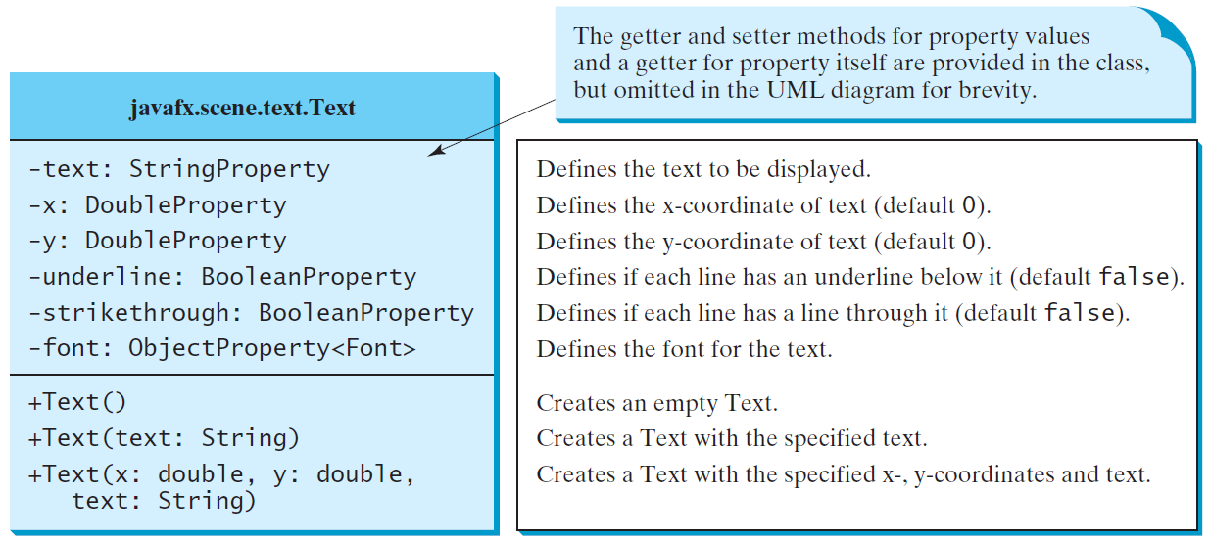
Text

Slide 24
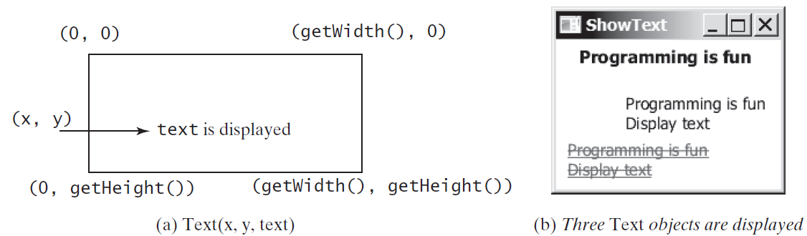
Text Example
ShowText
Run

Slide 25
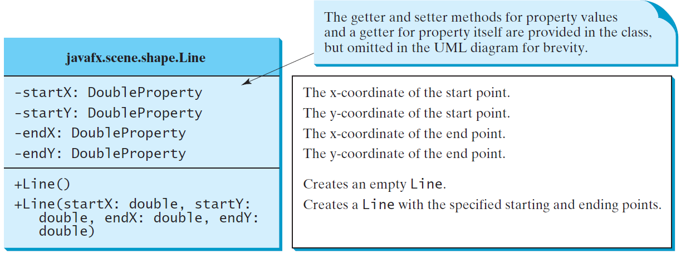
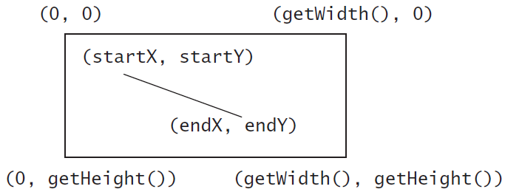
Line
ShowLine
Run

Slide 26
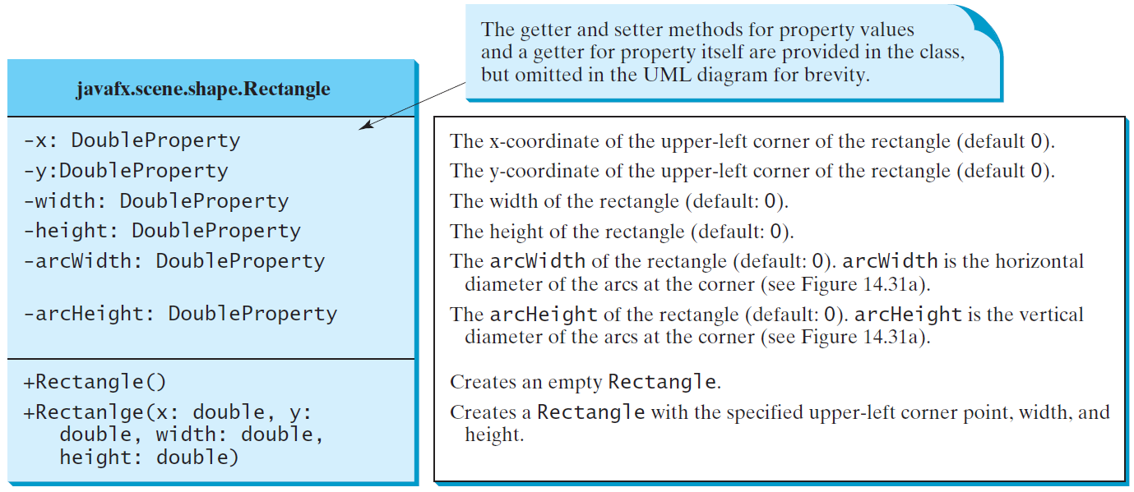
Rectangle

Slide 27
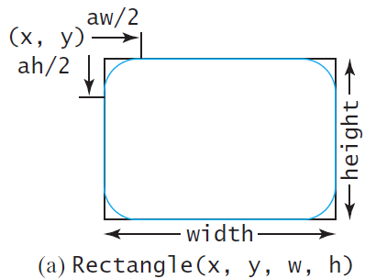
Rectangle Example
ShowRectangle
Run

Slide 28
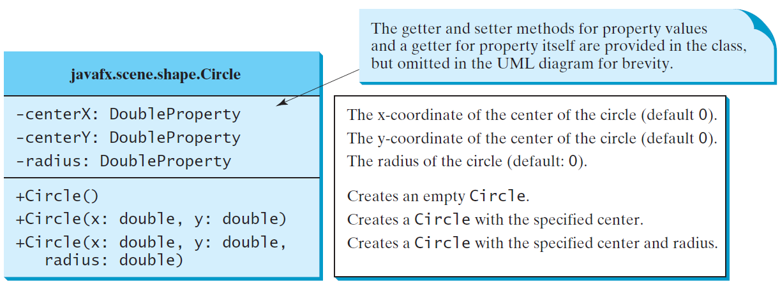
Circle

Slide 29
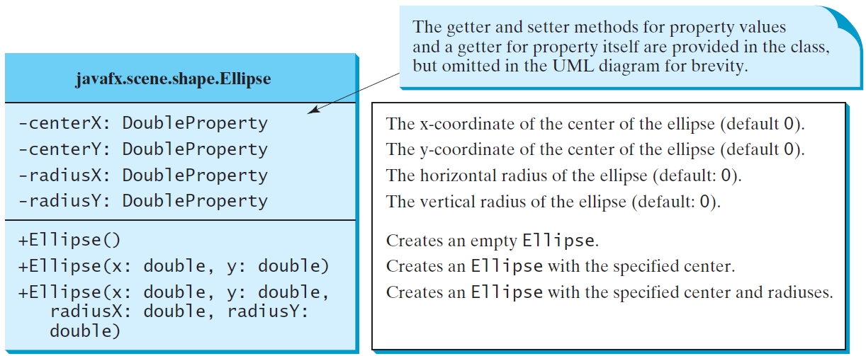
Ellipse
ShowEllipse
Run

Slide 30
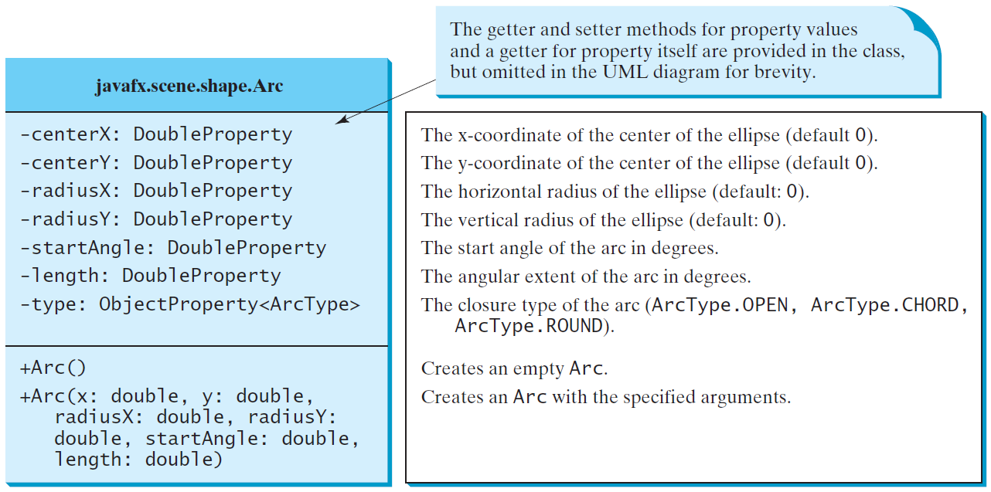
Arc

Slide 31
Arc Examples
ShowArc
Run

Slide 32
Polygon and Polyline
ShowArc
Run

Slide 33
Polygon
ShowPolygon
Run

Slide 34
Case Study: The ClockPane Class
This case study develops a class that displays a clock on a pane.
ClockPane

Slide 35
Use the ClockPane Class
DisplayClock
Run

